Slide 1
CDA 3101 Spring 2016 Introduction to Computer Organization
Instruction Set Architecture
MIPS Instruction Format
19 January 2016

Slide 2
The Instruction Set Architecture
Application (browser)
Operating
Software
Compiler
System
(Linux, Win)
Assembler
Instruction Set Architecture (ISA)
Datapath & Control
Memory
I/O System
Hardware
Digital Logic
Circuit Design
Transistors
Notes:
Discuss ISA in detail. It is the HW/SW interface. Before it was the only level available to programmers. Below ISA: hardware or SPIM Simulator. The architect should talks to both compiler/OS writers and hw engineers to find the features they want in the ISA. Tradeoff: simplicity (HW) high level operations/operands (SW). Cost/Efficiency (e.g. branch-and-do-payroll or memory whose address are prime numbers). Real-life issue: Compatibility. ISA design should last HW/SW trends.

Slide 3
Overview of the ISA Level
ISA: how the machine appears to a machine language programmer (compiler)
  Memory model
  Instructions
    Formats
    Types (arithmetic, logical, data transfer, and flow control)
    Modes (kernel and user)
  Operands
    Registers
    Data types
    Addressing
ISA formal defining documents
  A good example is the Java Virtual Machine (JVM)
  docs.oracle.com/javase/specs/jvms/se7/jvms7.pdf

Slide 4
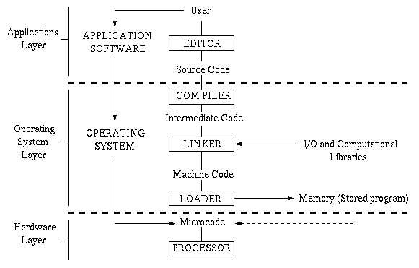
Computing Languages
Notes:
HW could execute directly C/Fortran: performance/flexibility (picojava II for binary JVM programs)

Slide 5
Computing Languages
High-level Language
temp = v[k];
v[k] = v[k+1];
v[k+1] = temp;
TEMP = V(K)
V(K) = V(K+1)
V(K+1) = TEMP
C/Java Compiler
Fortran Compiler
lw $t0, 0($2)
lw $t1, 4($2)
sw $t1, 0($2)
sw $t0, 4($2)
Assembly Language
MIPS Assembler
0000 1001 1100 0110 1010 1111 0101 1000
1010 1111 0101 1000 0000 1001 1100 0110
1100 0110 1010 1111 0101 1000 0000 1001
0101 1000 0000 1001 1100 0110 1010 1111
Machine Language

Slide 6
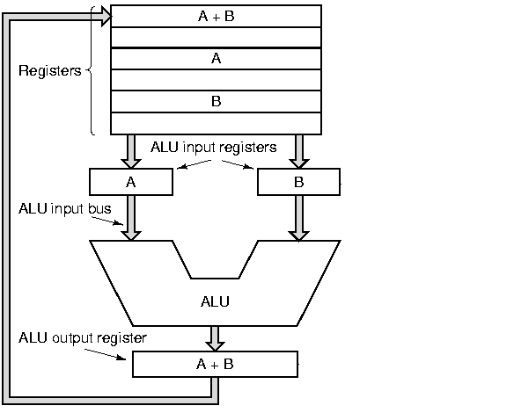
Program Execution
Datapath
Memory
0000 1001 1100 0110 1010 1111 0101 1000
1010 1111 0101 1000 0000 1001 1100 0110
1100 0110 1010 1111 0101 1000 0000 1001
0101 1000 0000 1001 1100 0110 1010 1111
...
program & data
I / O
Control
Fetch – Decode – Execute Cycle

Slide 7
MIPS Machine Language
Arithmetic
  add, sub, mult, div
Logical
  and, or, ssl (shift left logical), srl (shift right logical)
Data transfer
  lw (load word), sw (store word)
  lui (load unsigned immediate constant)
Branches
  Conditional: beq, bne, slt
  Unconditional: j (jump), jr (jump register), jal
Basic MIPS subset we will use for building MIPS datapath in CDA3101

Slide 8
MIPS Instructions
Simple (rigid) instructions (KISS principle)
  DP1: Simplicity favors regularity
  add a, b, c # a = b + c;
  # a = b + c + d + e;
  add a, b, c
  add a, a, d
  add a, a, e
These instructions are symbolic representations of what MIPS actually understands
Exactly 3 operands (registers)
comment
Format: <opcode> <output> <inp1> <inp2>
Notes:
Regularity: instructions 32 bits, fixed and simple formats => easy to fetch, decode, execute (cycle time, CPI), What about IC?

Slide 9
Example
Compiling a C assignment statement into MIPS
f = (g + h) – (i + j);
add t0, g, h # temporary variable t0 contains g+h
add t1, i, j # temporary variable t1 contains i+j
sub f, t0, t1 # f gets the final result
In MIPS, these are register names

Slide 10
Operands
Operands can not be any variable (as in C)
  KISS principle – avoid CISC pitfalls
Registers
  Limited number (32 32-bit registers in MIPS)
    DP2: Smaller is faster
  Naming: numbers or names
    $8 - $15 => $t0 - $t7 (correspond to temporary variables)
    $16 - $22 => $s0 - $s8 (correspond to C variables)
    Names make your code more readable
f = (g + h) – (i + j);
$s0 $s1 $s2 $s3 $s4
add $t0, $s1, $s2
add $t1, $s3, $s4
sub $s0, $t0, $t1
Notes:
Large number of registers would increase cycle time. It takes electronic signals longer when they must travel farther. 31 registers are faster than 32? Compilers want more registers. Effective use of registers is key to performance.

Slide 11
Register Conventions
Name
Register Number
Usage
Preserved on call
$zero
0
the constant value 0
n.a.
$at
1
reserved for the assembler
n.a.
$v0-$v1
2-3
value for results and expressions
no
$a0-$a3
4-7
arguments (procedures/functions)
yes
$t0-$t7
8-15
temporaries
no
$s0-$s7
16-23
saved
yes
$t8-$t9
24-25
more temporaries
no
$k0-$k1
26-27
reserved for the operating system
n.a.
$gp
28
global pointer
yes
$sp
29
stack pointer
yes
$fp
30
frame pointer
yes
$ra
31
return address
yes

Slide 12
Stored-Program Concept
Instructions are represented as 32-bit numbers
Programs can be stored in memory
  Can be read/written just like numbers
Payroll program
Payroll data
Processor
Word processor
Term paper
C compiler
Fetch-decode-execute cycle
Source C program

Slide 13
Memory
Contains instructions and data of a program
  Instructions are fetched automatically by the control
  Data has to be transferred explicitly back and forth between memory and processor
Data transfer instructions
address
data
load (lw)
0
1
2
3
4
Byte (8bits)
word
. . .
register file
save (sw)
.
.
.
.
.
.
processor
memory

Slide 14
Memory Model
Memory is byte addressable (1 byte = 8 bits)
Only load/store can access memory data
Unit of transfer: word (4 bytes)
  M[0], M[4], M[4n], …., M[4,294,967,292]
Words must be aligned
  Words start at addresses 0, 4, … 4n
Addresses are 32 bits long
  2³² bytes or 2³⁰ words

Slide 15
Load / Store
A[0] = h + A[2];
lw $t0, 8($s1)
add $t0, $s2, $t0
sw $t0, 0($s1)
.
.
.
Base address ($s1)
4n
4n+1
4n+2
4n+3
A[0]
Offset (8)
4n+4
4n+5
4n+6
4n+7
A[1]
4n+8
4n+9
4n+10
4n+11
$s0
$s1
$s2
4n
h
A[2]
.
.
.
registers

Slide 16
Big and Little Endian
(3101)₁₀ = 12 * 16² + 1 * 16¹ + 13 * 16⁰
= (00 00 0c 1d)₁₆
.
.
.
.
.
.
4n
4n+1
4n+2
4n+3
0 0
0 0
0 c
1 d
4n
4n+1
4n+2
4n+3
1 d
0 c
0 0
0 0
.
.
.
.
.
.
big endian
little endian

Slide 17
Review
ISA: hardware / software interface
MIPS instructions
  Arithmetic: add $t0, $s0, $s1
  Data transfer: lw/sw, for example: sw $t1, 8($s1)
Operands must be registers
  32 32-bit registers
  $t0 - $t7 => $8 - $15 (addresses)
  $s0 - $s7 => $16 - $23 (addresses)
Memory: large, single dimension array of bytes M[2³²]
  Memory address is an index into that array of bytes
  Aligned words: M[0], M[4], M[8], ….M[4,294,967,292]
  Big/little endian byte order

Slide 18
Conclusions
ISA should outlast technology trends
DP0: Simpler is better (KISS)
DP1: Simplicity favors regularity
  Simple instructions (avoid CISC pitfalls)
DP2: Smaller is faster
  A few registers replace C variables
MIPS memory model
  Byte addressable, Aligned, Linear array
Next Class: STARTING MIPS
Quiz #1 (Digital Logic) Thursday 21 Jan!!

